Slide 1


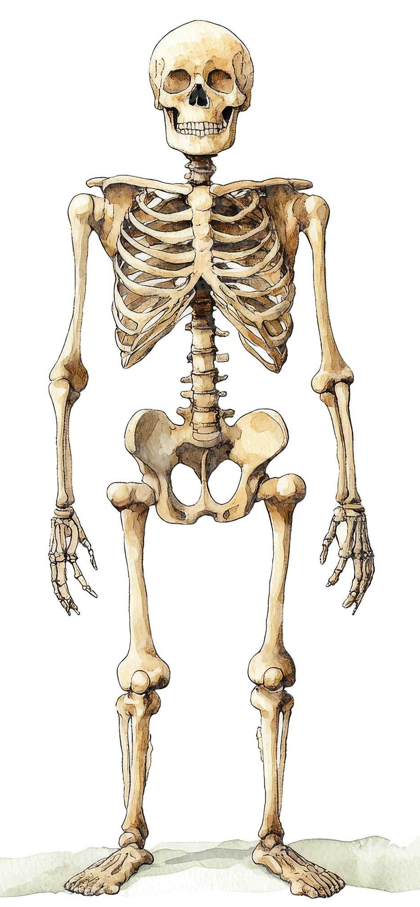

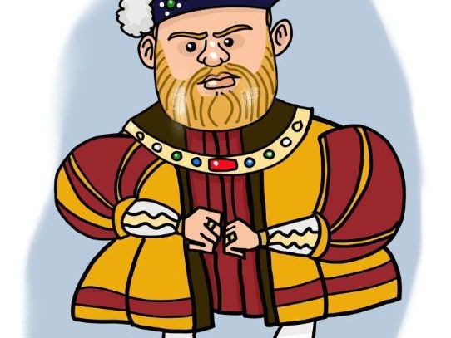

RE
In RE, we will be exploring and answering, ‘What kind of world did Jesus want?’ We will be reading different parables such as, ‘The Good Samaritan,’ and looking at the Gospel and what teachings we can gather from this.
Music
In Music we will continue to look at different music styles. We will be singing and learning instrumental parts. We will observe changes in dynamics and explore notation. Our unit is called, ‘Fly with the Stars.’
PSHE/ SRE
In PSHE, we will spend the first few lessons looking at allergies and learning the importance of noticing signs and symptoms of an allergic reaction. Children will understand what to do in a medical emergency. We will also be learning about our mental health and wellbeing.
Maths
In Maths, we will be looking at place value, using place value charts and number lines. We will also be focusing on addition and subtraction, counting in different variables. We will continue to practise our times tables regularly.
Miss McLauchlan’s Class
Autumn 1
What are we learning this half term?
Science
In Science, we will be learning about the topic, ‘Animals, including Humans,’ whilst also reflecting on prior learning.
We will be exploring food chains and the muscles and bones in the human body!
PE
This half term we will be focusing on invasion games, in particular Netball.
We will learn how to accurately receive and deliver a chest pass, whilst under pressure from defenders.
Spanish
In MFL, we will continue to build on our Spanish knowledge, revisiting prior learning.
This half term we will be learning about the seasons (Las estaciones)
Computing
We will be learning about Computing systems and networks, specifically, ‘The internet.’
This term a big focus will be on staying safe online and internet safety.
English
This half term we will be reading some very exciting books. Our class author for this term is David Walliams.
In English lessons, we will be focusing on the presentation of our writing, alongside in applying the correct punctuation to our sentences. I am looking forward to exploring the picture book, ‘Journey,’ by Aaron Becker.
History
This half term our topic is ‘Tudors.’
We will place this on a Chronological timeline and explore how long ago it was and how it differed living in Tudor times compared to today.
We will learn about Henry Viii and his impact on Britain today!
Art
In Art we will be researching and replicating art from famous artist, ‘Paul Cezanne.’
We will recreate techniques from his famous artwork, whilst applying it to our own work.

